Slide 1
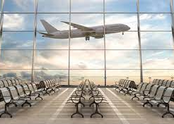
^{AIRBOURNE}
THE EFFECTS OF COVID ON TRAVEL

Slide 2
TEAM MEMBERS
Delfrieda mcknight
Jacqueline THOMPSON
JOAN Izundu
SHEILA CAVAZOS
TENISHA THOMPSON

Slide 3
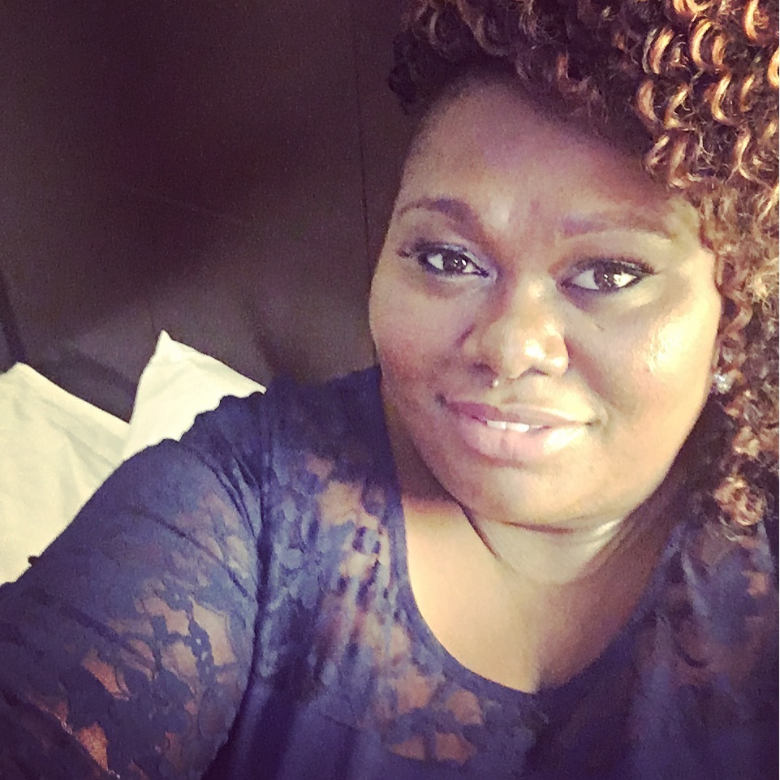
Delfrieda (Frieda) mcknight
Currently employed as a Fiscal analyst for Scdhhs (Medicaid)
Employment background: finance insurance, medical claims
Strengths: team player, trello, tableau
Hobbies: listenING to podcast, makeup and traveling
Interesting fact: I wanted to be a dental hygienist but realized I didn’t want to touch people

Slide 4
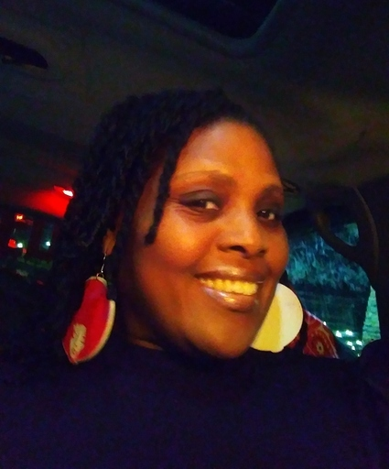
Jacqueline (JACKIE) THOMPSON
Currently employed: MetroTransit Bus Operator for the Metropolitan Council in Minneapolis, MN
Employment background: 16 years working as a Social Worker for The Bridge for Youth serving youth and families in crisis specifically system involved youth between the ages of 16 and 24, 9.5 years for MetroTransit as a Bus Operator
Strengths: Analyzing data and summarizing what it means, Python and R
Hobbies: Gardening ( I really love flowers and plants), Baking, Listening and reading music, and I love to laugh and enjoy the joys of life
Interesting fact: I know how to play the trumpet and piano

Slide 5
JOAN (JUNI) Izundu

Slide 6
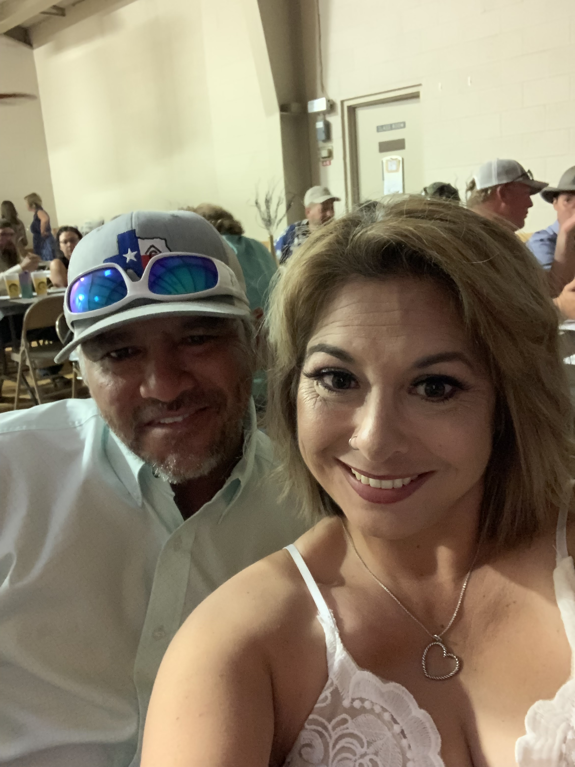
Sheila cavazos
Currently employed as a Credit Dispute Investigator
Employment background: Sales, insurance and data entry
Strengths: visualizations, graphics and python, tableau
Hobbies: reading, hiking, running, and being outdoors
Interesting fact: I live on a farm and raise pigs, COWS, AND CHICKENS

Slide 7
TENISHA THOMPSON

Slide 8
airbourne intorduction

Slide 9
methods

Slide 10
results

Slide 11
summary

Slide 12
conclusion

Slide 13
Questions?

